Slide 1
Extractive Text Summarization
VINEETH DAVIS G

Slide 2
Abstract
The main aim of this project is to extract contents from huge articles and summarize the content to a much more compact, readable and important piece of information to the user, based on ranking of sentences.

Slide 3
INTRO
Today we encounter a huge amount of data every now and then. It is almost impossible to read through every article and get insights from such huge volumes of data. Furthermore, a large portion of this data is not really useful information. The most efficient way to access the most important parts of data is to summarize the data in a way that only important pieces of information are left.
Through this project I attempt to tackle this problem using a method which is based on ranking of sentences to find the most important sentences found in a paragraph.

Slide 4
Method
Ranking of Sentences is a method by which a weightage or a score is determined to each sentence in the concerned paragraph. And later on after ranking these sentences based on their scores or weights obtained, the sentences with higher scores are filtered out and joined to form a sensible and readable format. which is the summary of the same text.

Slide 5
Text Summarization Steps
First a huge paragraph as input is required.
Convert paragraph into sentences
Text preprocessing
Tokenizing the sentences
Finding weighted frequency of occurrence of each words
Replace words by weighted frequency in original sentences and obtain sentence scores
Sort sentences in descending order of their sentence scores

Slide 6
1. Fetching articles from Wikipedia:
First the user needs to fetch an article from the web. To do so some libraries are required.: beautifulsoup4, urllib.request
The first preprocessing step is to remove references and other special characters from the article. Here re library can be used.
2. Preprocessing of the data:

Slide 7
3. Converting text to sentences
Next step is to tokenize the article into sentences. The paragraph can be split into sentences when it comes across periods.
Tokenizing words in these sentences and filtering out most common words: later each word from these sentences is drawn and seen if they are important or the ones which are to ignored. For that nltk and stopwords libraries are made use of.

Slide 8
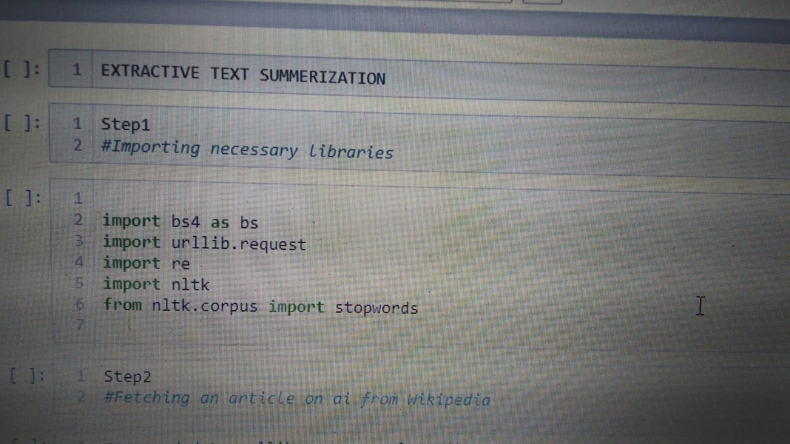

Slide 9
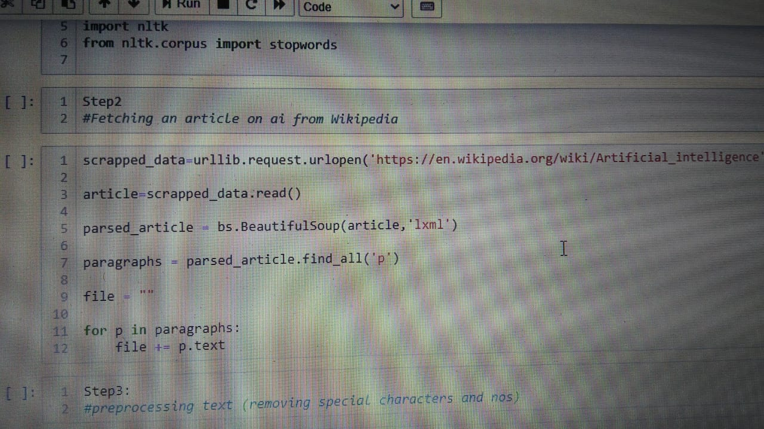

Slide 10
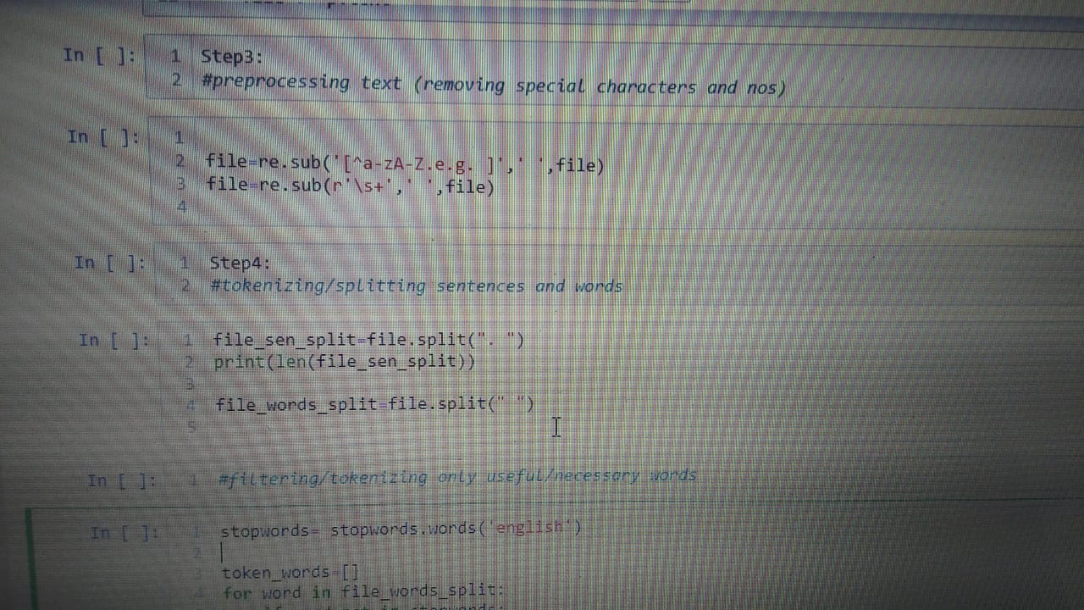

Slide 11
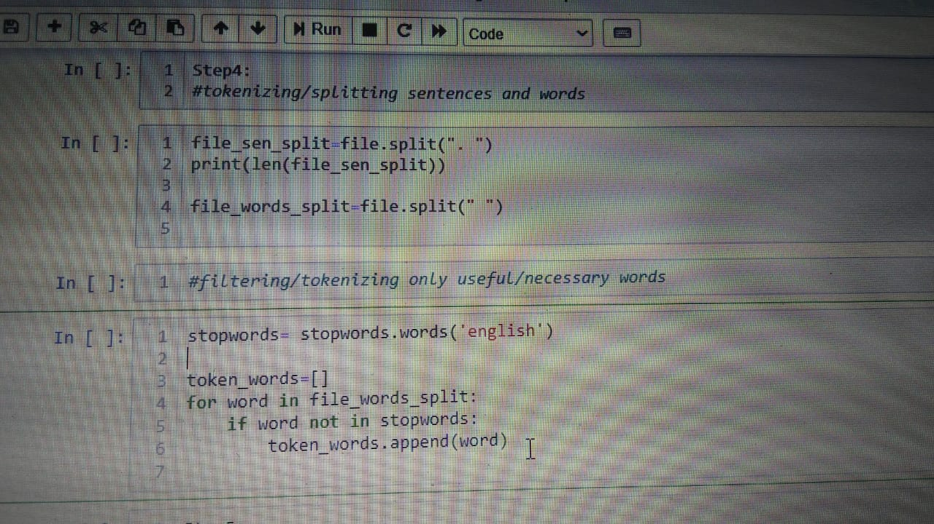

Slide 12
4. Finding weighted frequency of occurrence
To find weighted frequency of each word we find the no.of max. occurrence and keeping it as the standard all the other words are normalized to it to obtain scores for each word.
The resulting weighted frequencies for all the words are taken and each of them are found in that particular sentence are added. This step is done for every sentence in the paragraph and each sentence is scored.
5. Calculating sentence score

Slide 13
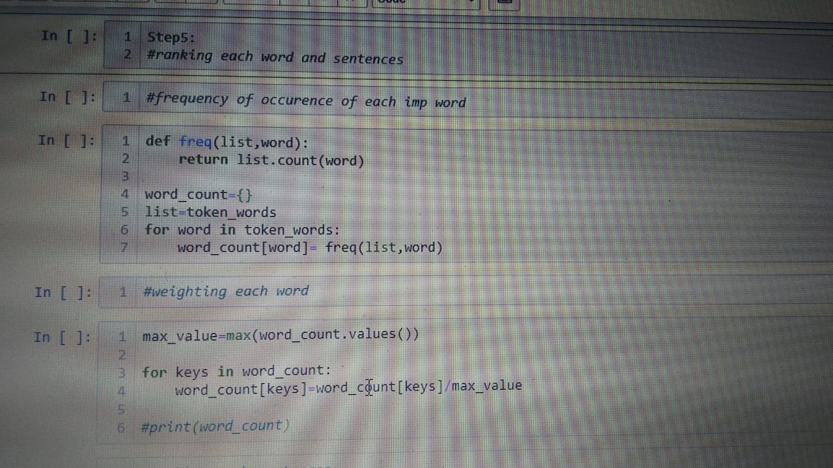

Slide 14
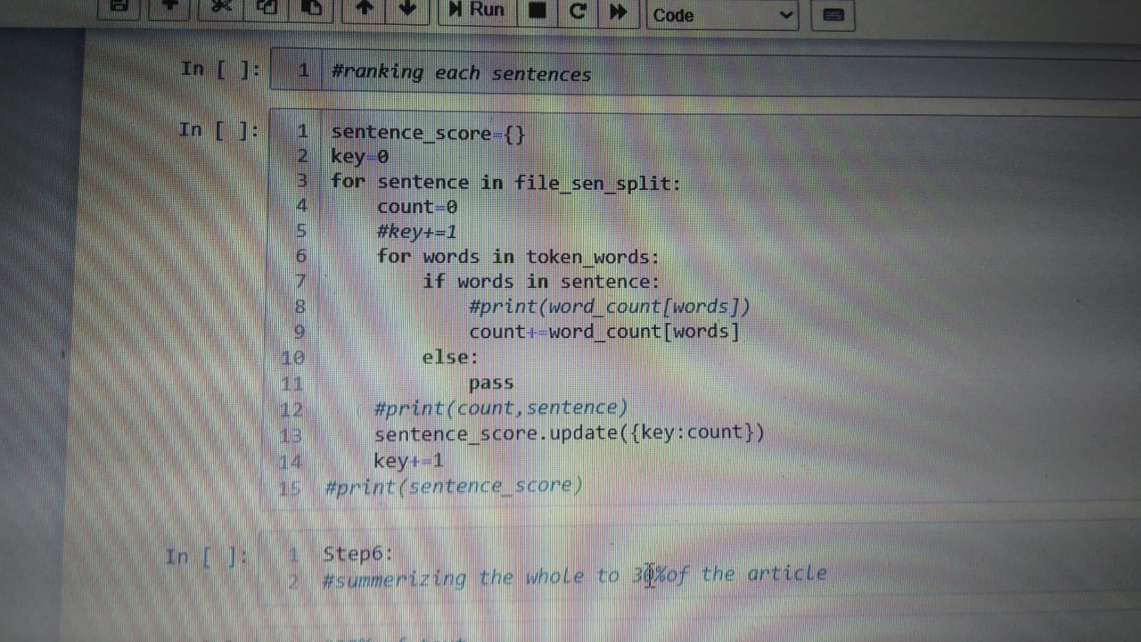

Slide 15
6. Getting the Summary
Now with the obtained sentence score we can take sentences with highest scores. And retrieve the same in descending order of scores. Thus obtained result is the summary of the article concerned.

Slide 16
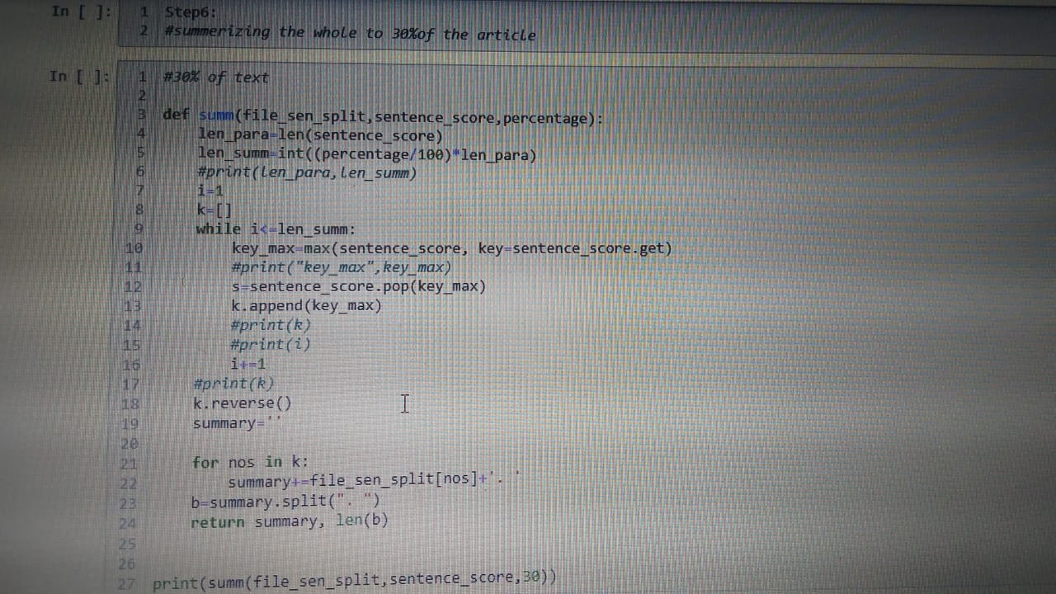

Slide 17
Results
With this code the user is able extract the summaries from most of the websites, which contain the desired article, by just giving the url. The programme finds all the content from the same and gives out a combat and useful summary of the same.

Slide 18
References
www.geeksforgeeks.org
www.wikipedia.com
https://stackabuse.com/text-summarization-with-nltk-in-python/
Youtube channels
www.google.com

Slide 19
THANK YOU

